Slide 1
Dockers & Containers

Slide 2
Containers vs. VMs
Containers share resources with the host OS, which makes them an order of magnitude more efficient. Containers can be started and stopped in a fraction of a second. Applications running in containers incur little to no overhead compared to applications running natively on the host OS.
The portability of containers has the potential to eliminate a whole class of bugs caused by subtle changes in the running environment—it could even put an end to the age-old developer refrain of “but it works on my machine!”
The lightweight nature of containers means developers can run dozens of containers at the same time, making it possible to emulate a production-ready distributed system. Operations engineers can run many more containers on a single host machine than using VMs alone.
Containers also have advantages for end users and developers outside of deploying to the cloud. Users can download and run complex applications without needing to spend hours on configuration and installation issues or worrying about the changes required to their system. In turn, the developers of such appli‐ cations can avoid worrying about differences in user environments and the avail‐ ability of dependencies.

Slide 3
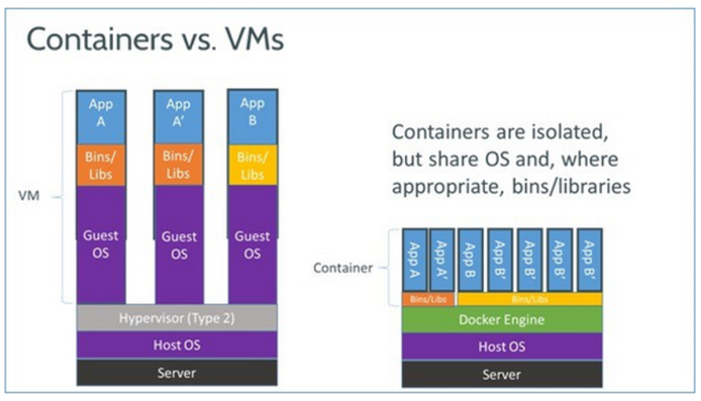
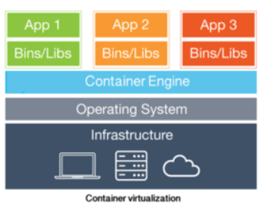
Containers/Dockers vs. VMs.

Slide 4
Linux cgroups vs. namespaces
cgroups and namespaces are the Linux kernel features that create the walls between containers and other processes running on the host.
Linux namespaces, originally developed by IBM, wrap a set of system resources and present them to a process to make it look like they are dedicated to that process.
Linux cgroups, originally developed by Google, govern the isolation and usage of system resources, such as CPU and memory, for a group of processes. For example, if you have an application that takes up a lot of CPU cycles and memory, such as a scientific computing application, you can put the application in a cgroup to limit its CPU and memory usage.
Namespaces deal with resource isolation for a single process, while cgroups manage resources for a group of processes.

Slide 5
LXC ( Linux Containers)
LXC is a Linux operating system-level virtualization method for running multiple isolated Linux systems on a single host.
Namespaces and cgroups features make LXC possible. (how?)
Containers decouple applications from operating systems, which means that users can have a clean and minimal Linux operating system and run everything else in one or more isolated container.
Also, because the operating system is abstracted away from containers, you can move a container across any Linux server that supports the container runtime environment.

Slide 6
Dockers vs Containers
What docker brings new to the table?

Slide 7
Single vs. multiprocess
Docker restricts containers to run as a single process. If your application environment consists of X concurrent processes, Docker wants you to run X containers, each with a distinct process.
By contrast, LXC containers have a conventional init process and can run multiple processes.
To run a simple multitier Web application in Docker, you would need a PHP container, an Nginx container (the Web server), a MySQL container (for the database process), and a few data containers for the database storage and other application data.
Adv: easy and more granular updates. Why shut down the database process when all you wanted to update is the Web server?
Also, single-process containers represent an efficient architecture for building microservices-based applications.
Limitations: can’t run agents, logging scripts, or an SSH daemon inside the container.
It’s not easy to commit small, application-level changes to a single-process container. You are essentially forced to start a new, updated container.

Slide 8
Stateless vs. stateful
Docker containers are designed to be stateless, more so than LXC.
First, Docker does not support persistent storage.
DOCKER VOLUME: Docker gets around this by allowing you to mount host storage as a “Docker volume” from your containers. Because the volumes are mounted, they are not really part of the container environment.
Second, Docker containers consist of read-only layers.
READ-ONLY: This means that, once the container image has been created, it does not change. During runtime, if the process in a container makes changes to its internal state, a “diff” is made between the internal state and the image from which the container was created.
If you run the docker commit command, the diff becomes part of a new image -- not the original image, but a new image, from which you can create new containers. Otherwise, if you delete the container, the diff disappears.
Adv: A stateless container is an interesting entity. You can make updates to a container, but a series of updates will engender a series of new container images, so system rollbacks are easy.

Slide 9
Portability
This is perhaps the single most important advance of Docker over LXC.
Docker abstracts away more networking, storage, and OS details from the application than LXC does.
With Docker, the application is truly independent from the configurations of these low-level resources.
When you move a Docker container from one Docker host to another Docker-enabled machine, Docker guarantees that the environment for the application will remain the same.
By this approach, Docker enables developers to set up local development environments that are exactly like a production server. When a developer finishes writing and testing his code, he can wrap it in a container and publish it directly to an AWS server or to his private cloud, and it will instantly work because the environment is the same.
Even with LXC, a developer can get something running on his own machine, but discover that it doesn’t run properly when he deploys to the server; the server environment will be different, requiring the developer to spend an enormous amount of time debugging the difference and fixing the issue.
Docker took away that complexity. This is what makes Docker containers so portable and easy to use across different cloud and virtualization environments.

Slide 10
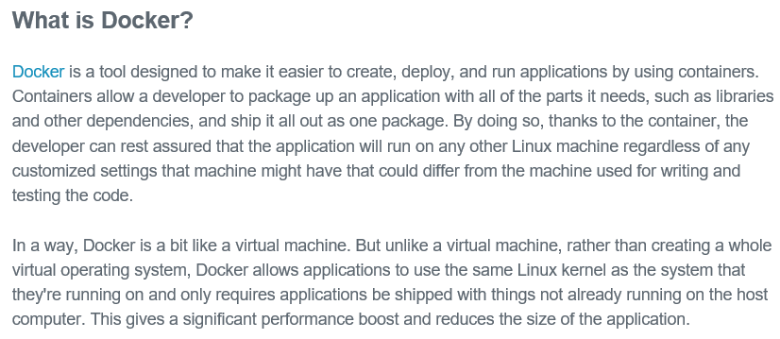
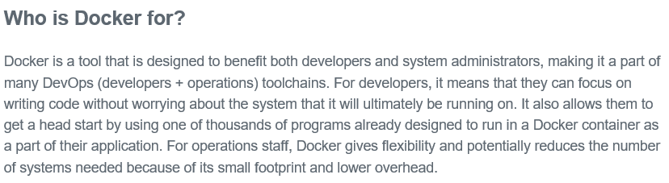

Slide 11
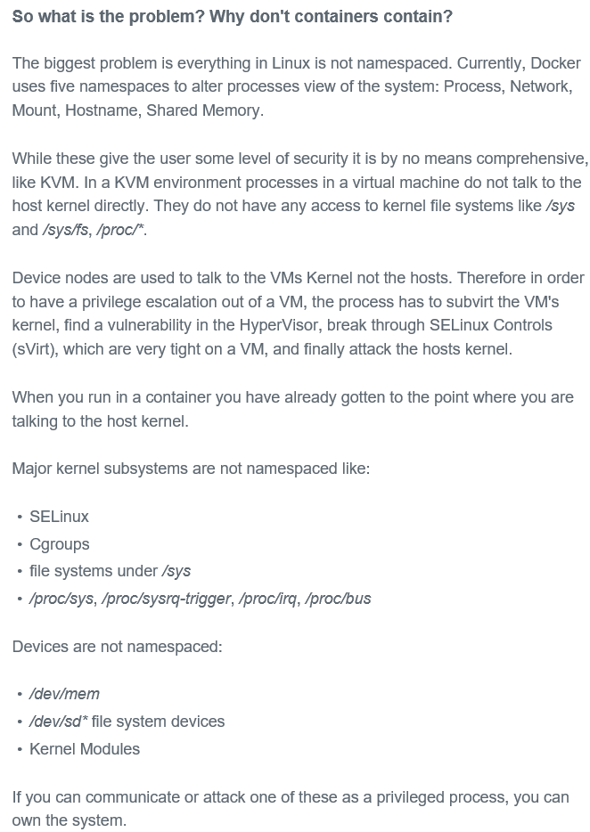
Security concerns in containers

Slide 12
Using Docker
Adrian Mouat

Slide 13
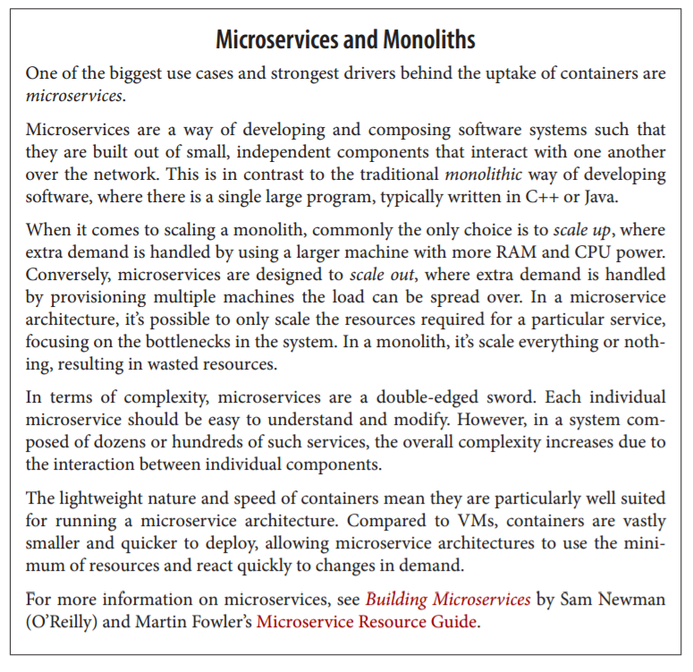

Slide 14
Installation

Slide 15
For Linux:
curl -sSL https://get.docker.com/ | sh
Or
wget -qO- https://get.docker.com/ | sh

Slide 16
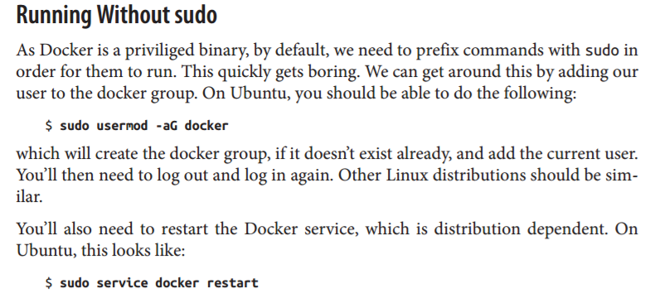

Slide 17
For Mac OS/Windows:
If you are using Windows or Mac OS, you will need some form of virtualization in order to run Docker.
Choice 1: You can download a full VM solution and follow the Linux instructions to install Docker.
Choice 2: Install the Docker Toolbox, which includes the minimal boot2docker VM as well as other Docker tools such as Compose and Swarm. (Recommended)
Once the Toolbox is installed, you can access Docker by opening the Docker quick‐ start terminal.

Slide 18
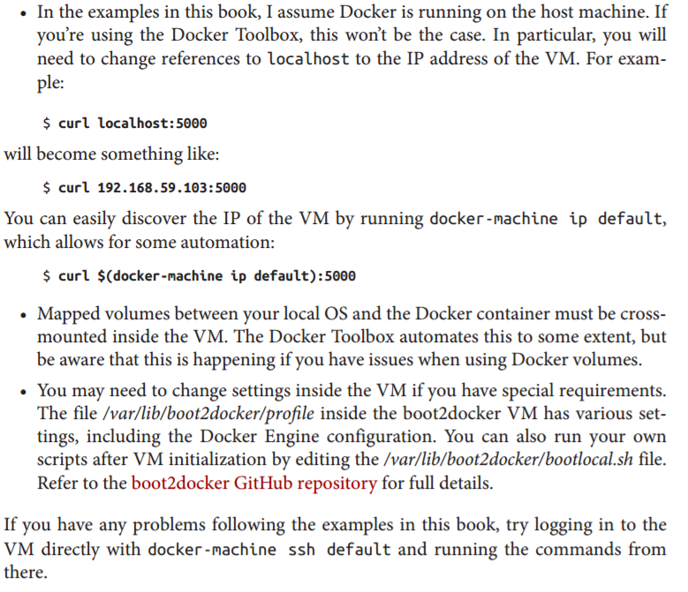
Beware of following while running Docker Toolbox

Slide 19
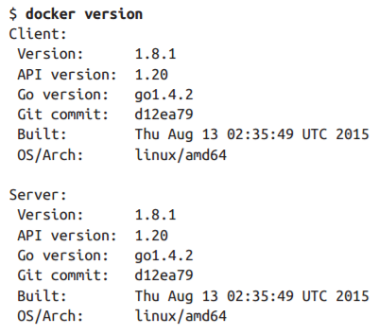
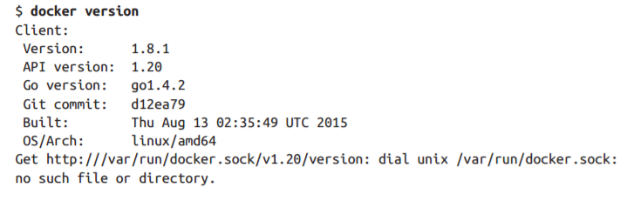
A Quick Check
Correct
Incorrect

Slide 20
First Steps

Slide 21

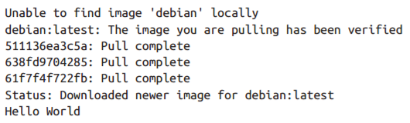
Running your first image

Slide 22
What happened?
We’ve called the docker run command, which is responsible for launching containers. The argument debian is the name of the image we want to use—in this case, a stripped-down version of the Debian Linux distribution. The first line of the output tells us we don’t have a local copy of the Debian image. Docker then checks online at the Docker Hub and downloads the newest version of the Debian image. Once the image has been downloaded, Docker turns the image into a running container and executes the command we specified—echo "Hello World"— inside it. The result of running this command is shown in the last line of the output.

Slide 23
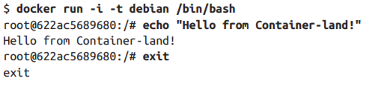
Invoking command prompt
This will give you a new command prompt inside the container, very similar to ssh’ing into a remote machine. In this case, the flags -i and -t tell Docker we want an interactive session with a tty attached. The command /bin/bash gives us a bash shell. When you exit the shell, the container will stop—containers only run as long as their main process.

Slide 24
Basic Commands

Slide 25



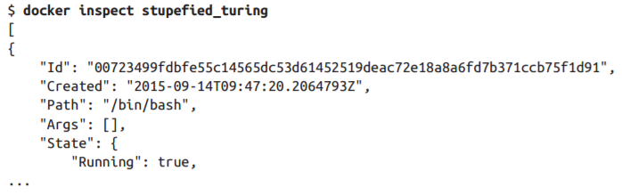
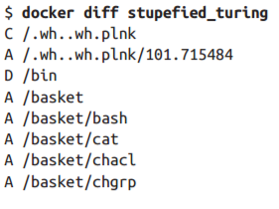


First, let’s launch a new container; but this time, we’ll give it a new hostname with the -h flag:
Let’s break the container:
Running “docker ps”:
Inspect & Diff:
Exiting:
Removing a container:

Slide 26
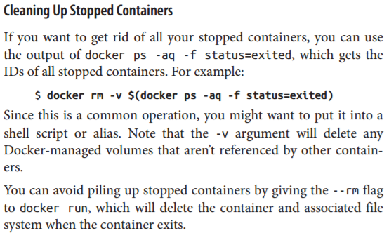

Slide 27
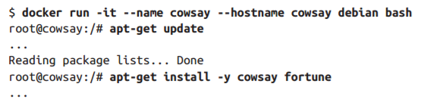
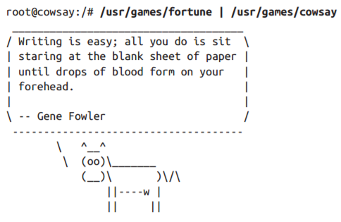

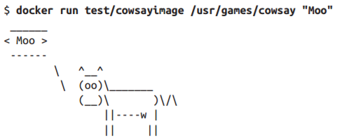
Creating another docker container and running “cowsay” application in it:
To turn it into an image, we can just use the docker commit command. It doesn’t matter if the container is running or stopped. To do this, we need to give the command the name of the container (“cowsay”) a name for the image (“cowsayimage”) and the name of the repository to store it in (“test”):
Now we have an image with cow‐ say installed that we can run:

Slide 28
Building Images from Dockerfiles

Slide 29


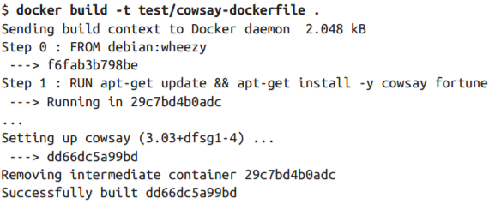
A Dockerfile is simply a text file that contains a set of steps that can be used to create a Docker image.
Insert the following in Dockerfile:
The FROM instruction specifies the base image to use (debian, as before; but this time, we have specified that we want to use the version tagged “wheezy”). All Dockerfiles must have a FROM instruction as the first noncomment instruction. RUN instructions specify a shell command to execute inside the image. In this case, we are just installing cowsay and fortune in the same way as we did before.
Build the image:→→→→→→→→→→→
Run the image:

Slide 30


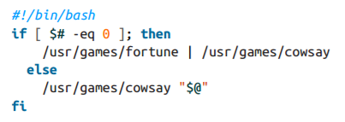
Introducing ENTRYPOINT
The ENTRYPOINT instruction lets us specify an executable that is used to handle any arguments passed to docker run.
Add the following to the Dockerfile:
Rebuild & run:
To be able to get the generic o/p and specific o/p from cowsay application:
Create a file entrypoint.sh with the following contents and save it in the same directory as the Dockerfile.
Set the file to be executable with chmod +x entrypoint.sh.

Slide 31
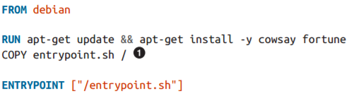
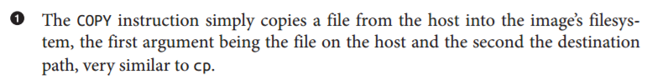
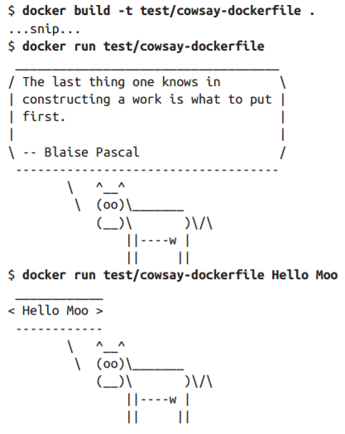
We next need to modify the Dockerfile to add the script into the image and call it with the ENTRYPOINT instruction. Edit the Dockerfile so that it looks like:
Testing it out with and without arguments:

Slide 32
Working with registeries

Slide 33
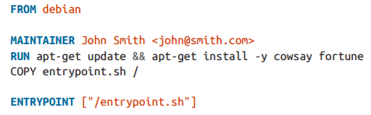

In order to upload our cowsay image, you will need to sign up for an account with the Docker Hub (either online or using the docker login command). After you have done this, all we need to do is tag the image into an appropriately named repository and use the docker push command to upload it to the Docker Hub.
First, let’s add a MAINTAINER instruction to the Dockerfile, which simply sets the author contact information for the image:
Now let’s rebuild the image and upload it to the Docker Hub.
You will need to use a repository name that starts with your username on the Docker Hub (in this case, amouat), followed by / and whatever name you want to give the image. For example:
As we didn’t specify a tag after the repository name, it was automatically assigned the latest tag. To specify a tag, just add it after the repository name with a colon (e.g., docker build -t amouat/cowsay:stable .)
Once the upload has completed, the world can download your image via the docker pull command (e.g., docker pull amouat/cowsay).

Slide 34
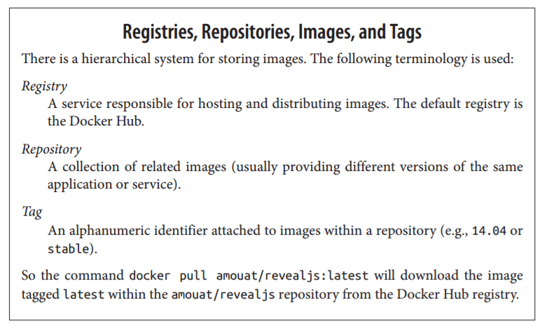

Slide 35
Image Namespaces
Names prefixed with a string and /, such as amouat/revealjs, belong to the “user” namespace. These are images on the Docker Hub that have been uploaded by a given user. For example, amouat/revealjs is the revealjs image uploaded by the user amouat.
Names such as debian and ubuntu, with no prefixes or /s, belong to “root” name‐ space, which is controlled by Docker Inc. and reserved for the official images for common software and distributions available from the Docker Hub. There are official images for most common software packages, which should be your first port of call when looking for an image to use.
Names prefixed with a hostname or IP are images hosted on third-party regis‐ tries (not the Docker Hub). These include self-hosted registries for organizations, as well as competitors to the Hub, such as quay.io. For example, localhost: 5000/wordpress refers to an WordPress image hosted on a local registry.

Slide 36
Using the official Redis image

Slide 37


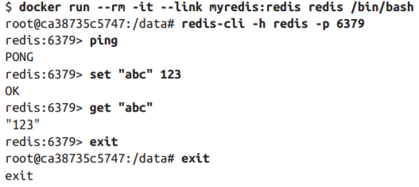
Start by getting the image:
Start up the Redis container, but this time use the -d argument:
The -d tells Docker to run the container in the background. Docker starts the con‐ tainer as normal, but rather than printing the output from the container, it returns the containers ID and exits. The container is still running in the background, and you can use the docker logs command to see any output from the container.
Linking two containers:
We launched a new container to run redis-cli in it and linked the two containers.

Slide 38

Persistence (Backing Up) of data
Docker provides this through the concept of volumes.
Volumes are files or directories that are directly mounted on the host and not part of the normal union file system. This means they can be shared with other containers and all changes will be made directly to the host filesystem.
There are two ways of declaring a directory as a volume:
Using the VOLUME instruction inside a Dockerfile:
Specifying the -v flag to docker run.
Both the following Dockerfile instruction and docker run command have the effect of creating a volume as /data inside a container.
By default, the directory or file will be mounted on the host inside your Docker installation directory (normally /var/lib/docker/).

Slide 39
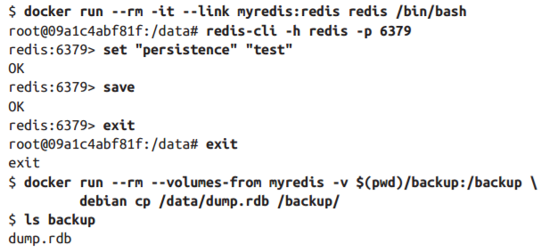
It is possible to specify the host directory to use as the mount via the docker run command (e.g., docker run -d - v /host/dir:/container/dir test/webserver).
Applying this on the Redis container that we had created:
We use the –v argument to mount a known directory and --volumes-from argument to load the volumes from another container. (in this example, myredis)

